Slide 1
The experience of implementing Bologna-reforms: development of QA system in accordance with the standards and guidelines of the EHEA.
Tove Blytt Holmen, ENQA
QA-seminar Bishkek 10. -11. March 2017
Notes:
I know little about higher education in Kyrgyzstan. However, I am 100 % certain that you all have ambitions to build up, maintain and develop higher education of high quality. And I am sure that you want other countries to see this too, so that you can attract more students, teachers and projects. For this purpose you will need academic freedom, academic competence and sufficient resources.
You also have to have a well functioning quality assurance in place: systematic quality work that documents results and further improvements. You will need to adapt to transparency (for good days and for worse) and to involve students
The Bologna-process aim at strengthening convergence and compatibility in the European Higher education Area (EHEA). That does not however mean that higher education should be identical to each other. On the contrary: flexibility and divergence are appreciated values.
It is a great pleasure for me to attend this seminar. This is an important event, to gather so many so important people for the quality and quality management of higher education.
I believe that the Bologna-process has had a surprisingly strong impact on many issues. And that this, through the almost twenty years since the initial signatures, have brought higher education in the European Area closer together

Slide 2
Bologna-reform, some elements:
Degree structure, 3 + 2 + 3, Bachelor + Master + Ph.D. (1999)
Quality Assurance
Systematizing internal QA + external QA, Quality Assurance Agencies
ESG (2005 and 2015)
“The European Higher Education Area”, EHEA (2010)
European Qualification Framework and Learning Outcome Descriptors (Norwegian QF 2013)
ECTS (users’ handbook) (2015)
Growing focus on Internationalization and Joint Programmes (2015)
Steady progress in almost …
Notes:
The Bologna-declaration is the Joint declaration of the 29 European Ministers of Education convened in Bologna on 19 June 1999. This declaration is the main guiding document of the Bologna process.
It proposed a European Higher Education Area in which students and graduates could move freely between countries, using prior qualifications in one country as acceptable entry requirements for further study in another.
One of the principal aims agreed were: "Adoption of a system of easily readable and comparable degrees". The 3 + 2 + 3 model was identified. That is to say, countries should adopt common structures, terminology and standards
Quality Assurance another of the Process’s main pillars has become a real success story!
Internal QA: the institutions’ own quality work, policy + system + implementing real quality work
External QA: Is when an independent, external body like the QA agency reviews the institution
In this context, external and internal QA build upon each other (one is not complete without the other)
Also in the Bologna-process:
recognition
the social dimension of HE;
employability of students;
student centred learning

Slide 3
What is ENQA?
ENQA is a membership organisation of external Quality Assurance Agencies
→ sharing of good practice and experiences, building QA policy and expertise
Represents members in European level policy making; supports members nationally; facilitates networking and sharing of good practice, joint projects, and reflections on QA; coordinates external reviews of QA agencies
The criteria for membership is that an agency undergoes a successful external review against the 2015 European Standards and Guidelines (ESG) every five years
Notes:
My logo here is ENQA - what is ENQA?
ENQA is … (read the picture)

Slide 4
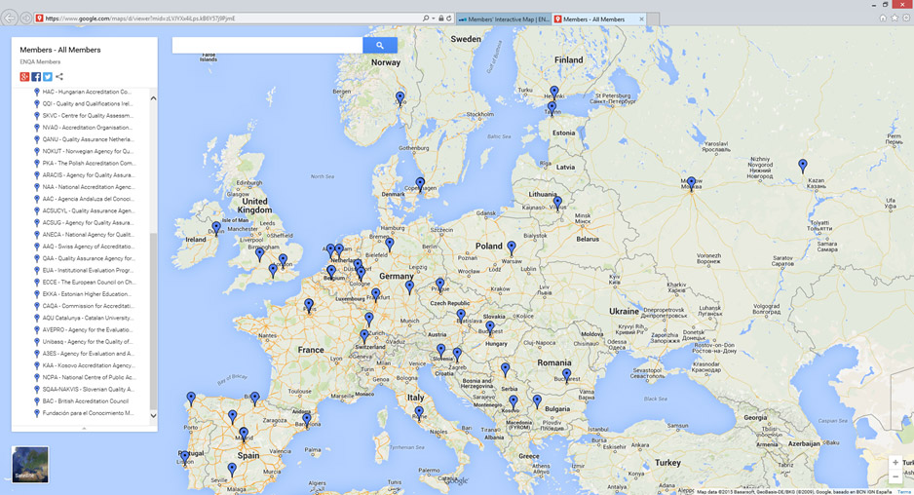
ENQA – member agencies, 49 in 27 countries
Notes:
Kazakhstan, by IAAR (Independent Agency for Accreditation and Rating) was welcomed as an ENQA member 30 November 2016, after this illustration was made.

Slide 5
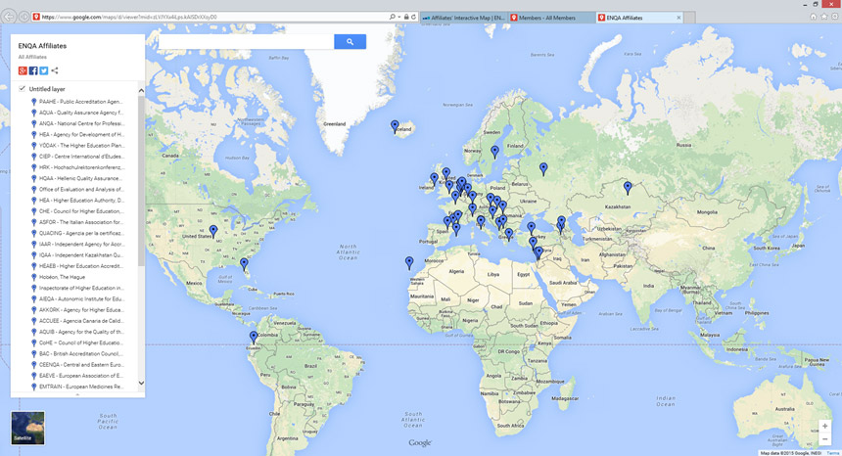
ENQA – affiliates 53 in further 16 countries
Notes:
Kazakhstan, by IAAR (Independent Agency for Accreditation and Rating) is now a full member

Slide 6
European Standards and Guidelines
Prepared by stakeholders and signed by ministers
The ESG provide guidance, covering the areas which are vital for successful quality provision and learning environments in higher education. The ESG are not standards for quality itself.
The standards are generic; they allow for diversity within a common framework
Focus on quality assurance of learning and teaching, now also with links to research and to the learning environment
List the main principles of QA in Europe
Notes:
QA involves stakeholders and takes into account the expectations of all stakeholders and society

Slide 7
Main principles for QA in Europe
HEIs have primary responsibility for the quality of their provision and its assurance
EQA shall respond to the diversity of higher education systems, institutions, programmes and students
QA supports the development of a quality culture
QA takes into account the needs and expectations of students, all other stakeholders and society → strong importance for stakeholder involvement!
___
QA should combine the purposes of accountability and enhancement
Safeguard the independence of QA agencies
Notes:
That the university itself has the primary responsibility for the quality of its own provisions/studies seems obvious. Nevertheless it is stated in the various laws regulating higher education across Europe.
EQA, the external quality assurance in higher education, (preformed by agencies), even though it is based upon ESG, shall always respond to the diversity in the country and in the sector
QA and quality work in general is not to be done by quality professionals alone but by involving all parties: the students, the teachers, the leaders on all levels. A quality culture does not come by itself, but evolves around structures like a quality policy, a quality system and a well functioning quality work
… … that takes into account the needs, experience and expectations of student and main stakeholders.
___
The statement that QA should combine the purposes of accountability and enhancement is not an explicitly stated principle. However, it is a statement that is penetrating all modern quality work.
Nor Independence of QA agencies is a principle. It is one of the standards. Even so I always point on independence from the beginning: The QA agency should not be a part of, or under too strong influence of the ministry

Slide 8
Purposes of the ESG 2015
Set a common framework for quality assurance systems for learning and teaching at European, national and institutional level
Enable the assurance and improvement of quality of higher education in the European higher education area
Provide information on quality assurance in the EHEA
Support mutual trust, thus facilitating recognition and mobility within and across national borders
Notes:
As the degree structure 3 + 2 + 3 years or Bachelor + Master + Ph.D set a common framework for the higher education itself,
the ESG set a common framework for the Quality assurance of higher education
As these standards, ESG, are developed by the main stakeholders in higher education, we believe they are important to enable both the assurance and the improvement of quality
The more countries that adapt to the ESG the more this will facilitate recognition, mobility and trust

Slide 9
The Minister
HEIs
Bologna,
EHEA
The QA Agency

Slide 10
ESG: The three parts
Part I - Internal QA within the institution
Part II - External QA by the Agency
Part III - Internal QA and operation of the Agency itself
Covers the entire QA cycle
at all levels

Slide 11
Part 1: Institutions’ internal quality assurance
1.1 Policy for quality assurance
1.2 Design and approval of programmes
1.3 Student-centered learning, teaching and assessment
1.4 Student admission, progression, recognition and certification
1.5 Teaching staff
1.6 Learning resources and support
1.7 Information management
1.8 Public information (2.6 on reporting)
1.9 On-going monitoring and periodic review of programmes
1.10 Cyclical external quality assurance
Notes:
Are you familiar with the ESG?
This picture shows the standards to which European Higher Education Institutions have to comply.
The standards given in the document are obligatory, the guidelines are what they claim to be: guidelines.
Even if you are not a part of the EHEA, I recommend you both to read and try to implement these standards. To me at least, they make up a useful tool to quality assurance.
Which standard do you think will be the most challenging?

Slide 12
Part 1: Institutions’ internal quality assurance
1.1 Policy for quality assurance
1.2 Design and approval of programmes
1.3 Student-centered learning, teaching and assessment
1.4 Student admission, progression, recognition and certification
1.5 Teaching staff
1.6 Learning resources and support
1.7 Information management
1.8 Public information (2.6 on reporting)
1.9 On-going monitoring and periodic review of programmes
1.10 Cyclical external quality assurance

Slide 13
Trends in European QA
Possible move to “softer” approaches (fitness-for-purpose), especially in well-established QA systems: from programme to institutional approaches; risk-based methods; more flexible methods or methods based more on institutional priorities
Going beyond minimum standards and find ways to measure and reward excellence
Greater importance given to the usefulness and readability of reports (competing with international or national rankings as information source?)
External accountability of agencies is widely accepted – and expected (ENQA/EQAR)
Wider involvement of stakeholders accepted and required
By far most EHEA countries have now an independent QA agency, compared to a minority 10 years ago
Notes:
Read the text
Involving stakeholders: Again and again: involve students!

Slide 14
Some challenges in European QA
Adapting to the requirements in ESG 2015: “good practice” in many agencies for several years BUT for some agencies big changes are still ahead
student involvement
publication of reports
collaborative relationship with HEIs
QA of alternative delivery modes (elearning), etc.
Internationalisation of QA agencies
use of international reviewers
international collaborative projects
joint reviews or cross-border reviews
Notes:
Resources, restrictions
Again: Institutions have to accept and appreciate student involvement
ESG requires publishing of full reports, both the once with a positive conclusion and those who are negative
The agencies have to keep an arm length distance to both the Ministry and the institutions. However the Agency’s external QA on institutions should be build on purposeful communication, involving institutions, and other stakeholders in designing the methods and criteria
Internationalisation read the text

Slide 15
Remember:
ESG 2015 is about quality assurance
Quality has no universal definition
Quality is contextual and subjective
Learn ESG 2015 and your institution’s quality policy by heart
Teachers + students + administration: Togetherness makes a difference

Slide 16
Thank you! www.enqa.eu tove.blytt.holmen@nokut.no

