Slide 1
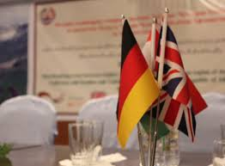
Internship in GIZ “Mineral Resources for Development”
Dushanbe,Tajikistan
Ganieva Gulfiza, ES-111
ganievagulfiza@gmail.com
Notes:
Under a co-financing arrangement with the UK’s Department for International Development (DFID) and on behalf of BMZ, GIZ is implementing the Framework and Finance for Private Sector Development programme. In this context, GIZ supports private sector development and the abolition of trade barriers and provides advisory services for the microfinance and resource sectors.
Besides promoting economic development and improving living conditions, GIZ’s engagement on behalf of the German Government and other donors is helping to stabilise the region as a whole.

Slide 2
Agenda
Quick facts
Introduction to Organizations
Duties
Theory-Practice Reflexion
Challenges
New gained skills
Future development

Slide 3
Motivation
GIZ announcement Study requirements
Unique chance to experience working in international organization and public institution
Application and Acceptance

Slide 4
Quick Facts
Overall 463 hours from 2nd of June – 5th of August 2014
2 different institutions, organization supervisors, offices, and tasks
An official position - short terms assistant

Slide 5
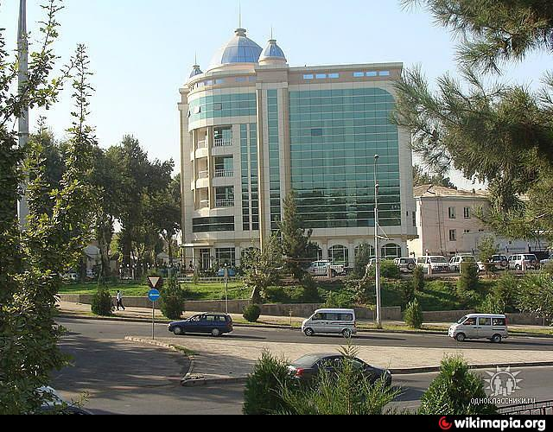
GIZ-Tajikistan
GIZ – German Cooperation for International Development, commissioned by German Federal Ministry for Economic Cooperation and Development
GIZ Tajikistan – 17 projects and programs:
Sustainable Infrastructure
Social Development
Governance and Democracy
Environment and Climate Change
Economic Development and Employment
Mineral Resources for Development
Notes:
Sustainable Infrastructure (water management)

Slide 6
Mineral Resources for Development
MRD – regional program, where objective is to use mineral resources for inclusive economic development in Kazakhstan, Kyrgyzstan, Tajikistan
Main obstacles of the program?
unfavorable conditions for investment,
inadequate geo-economic information and technology,
lack of efficiency in training and other relevant institutions
Approach:
organization of private-public dialogue platforms at the national and regional level,
Providing assistance to the state authorities, support, consultations and policy advises.

Slide 7
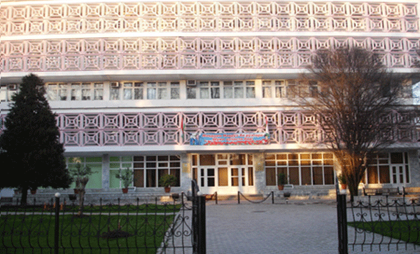
MINT-Tajikistan
MINT – Ministry of Industry and New Technologies of the Republic of Tajikistan
International Relations Department
Mining and Metallurgical
Machinery
Light Industry
Coal Industry

Slide 8
Duties and Field of Work
Translation Russian-English-Russian;
Providing administrative support;
Clerical duties, including maintaining a good flow of communication and information inside the International Department at MINT and externally: development partners, other government agencies, and rest of GIZ;
Coordinating and organizing important grand events;
Assisting with the implementation of running the Mineral Resources for Development Regional Program.
Short term assistant has became a combination of: office clerk, receptionist, translator, office-manager, personal assistant, logistician, representative on behalf of the ministry during external meetings, etc.

Slide 9
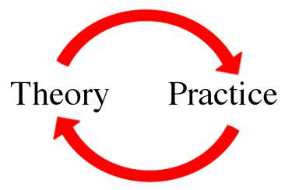
Theory-Practice
Language skills
Ability to conduct a research and computer skills
Cultural communication and tolerance
Basic knowledge on economy and law terminologies and concepts
Critical thinking

Slide 10
Challenges
Having 2 organization supervisors is stressful
Working at the governmental institutions requires strict discipline and formality
Saying “no” is not easy

Slide 11
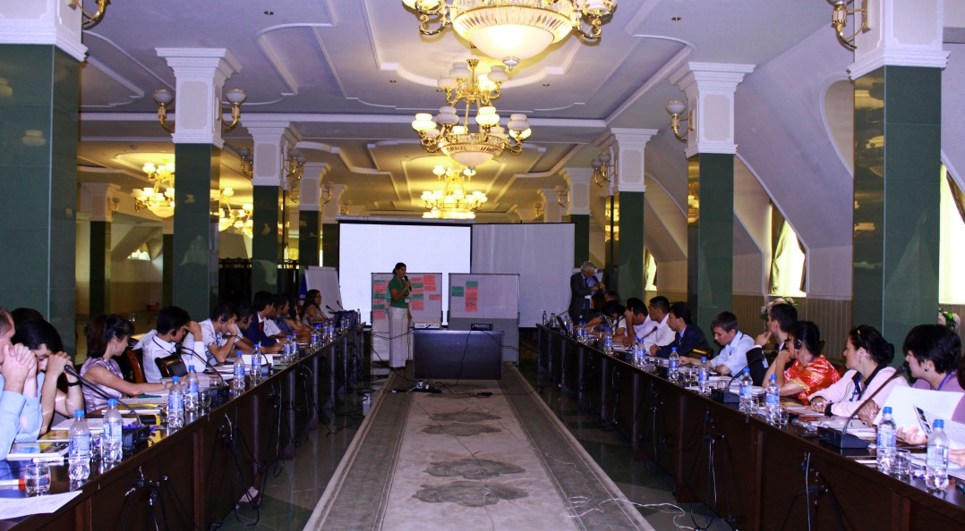
New Skills
Improvement of time and task management
Networking
Working in a team, and developing leadership
Understanding the values and culture of international organization and governmental institution in Tajikistan
Widening knowledge on economy and mining in Tajikistan

Slide 12
Conclusion: Future Development
Governmental structures do not give space to develop, but welcome ideas and new practices
Masters Degree on Natural Resources Management is and will continue to be valuable in Central Asian Countries
I was advised to continue my career in international organizations, where the main objectives are sustainable economical development, conflict resolution, rule of law.

